Slide 1
UNIT-6 Big Data Analysis Techniques

Slide 2
What is data analysis and why is it important?
Data analysis is, put simply, the process of discovering useful information by evaluating data.
This is done through a process of inspecting, cleaning, transforming, and modeling data using analytical and statistical tools.
why is it important?
Analyzing data effectively helps organizations make business decisions.

Slide 3
Data analysis is important because it helps businesses optimize their performances.
Implementing it into the business model means companies can help reduce costs by identifying more efficient ways of doing business and by storing large amounts of data.
A company can also use data analytics to make better business decisions and help analyze customer trends and satisfaction, which can lead to new—and better—products and services.

Slide 4
Data Analysis Steps
The process involved in data analysis involves several different steps:
The first step is to determine the data requirements or how the data is grouped. Data may be separated by age, demographic, income, or gender. Data values may be numerical or be divided by category.
The second step in data analytics is the process of collecting it. This can be done through a variety of sources such as computers, online sources, cameras, environmental sources, or through personnel.
Once the data is collected, it must be organized so it can be analyzed. This may take place on a spreadsheet or other form of software that can take statistical data.
The data is then cleaned up before analysis. This means it is scrubbed and checked to ensure there is no duplication or error, and that it is not incomplete. This step helps correct any errors before it goes on to a data analyst to be analyzed.

Slide 5
Data Analysis
How you analyze your data depends on the type of data you’re dealing with—quantitative or qualitative.
What is the difference between quantitative and qualitative data?

Slide 6
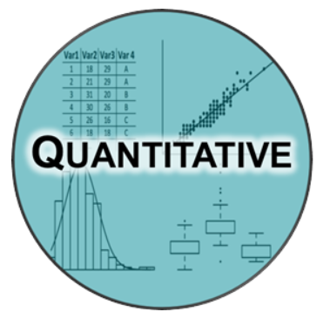
Quantitative data Analysis
Quantitative data is anything measurable, comprising specific quantities and numbers.
Some examples of quantitative data include sales figures, email click-through rates, number of website visitors, and percentage revenue increase.
Quantitative data analysis techniques focus on the statistical, mathematical, or numerical analysis of (usually large) datasets.
This includes the manipulation of statistical data using computational techniques and algorithms.
Quantitative analysis techniques are often used to explain certain phenomena or to make predictions.

Slide 7
Steps in big data analytics
Collect Data
Process Data
Clean Data
Analyze Data
Data Mining
Predictive analysis
Deep learning

Slide 8
Actually quantitative analytics uses such traits to create datasets that managers can consider when making strategic decisions. Examples of this could include the following:
Using web traffic data to identify what areas of a website are most frequently visited.
Using services such as Google Analytics to determine what search terms most commonly lead customers to your website.
Using website traffic data to determine when potential customers are abandoning the conversion funnel and not completing the transaction, then using this data to make changes to improve conversion numbers.
In all the above cases, quantitative analysis is used to come up with hard data that leads to better decisions.
Because quantitative analysis strips all issues down to facts and figures, all ambiguity of language, interpretation, and emotion is removed. If done properly using strict rules, smaller datasets can be extrapolated to analyze and predict the behavior of larger groups.
For example, if 700 out of 1000 potential customers abruptly leave your website from the same page, it’s reasonable to assume this is happening at a similar ratio with larger amounts of customers.

Slide 9

Qualitative data Analysis
Qualitative data cannot be measured objectively, and is therefore open to more subjective interpretation.
Some examples of qualitative data include comments left in response to a survey question, things people have said during interviews, tweets and other social media posts, and the text included in product reviews.
With qualitative data analysis, the focus is on making sense of unstructured data (such as written text, or transcripts of spoken conversations).
Often, qualitative analysis will organize the data into themes—a process which, fortunately, can be automated.

Slide 10

Example
Take a business, say interior designing. Initially, for any project, the business first needs an overall idea of qualitative data such as what features the customer wants, the changes to be made, color combinations, etc.
But this data, by itself, is not sufficient. It is also necessary to define the quantity of each item in the space to make the look simple and elegant.
The image is of a room depicting the color combination of walls, curtains, and other items.

Slide 11
Cont…
Qualitative Observation: Walls of the room are painted in light green color with green floral curtains on the windows, a brown desk with a brown chair finished with green fabric.
An emerald green block lamp resting on the desk. Wall art hangs on the light green wall between the windows.
Quantitative Observation: Painted two walls in each room, added 120″ drapes, placed brown desk of Width: 47 1/4 “, Depth: 18 1/2 “, Height: 29 1/2 “. Max load/shelf: 33 lb.
Emerald green block lamp of height 51cm and width 20cm. Wall art of size 20×16”.

Slide 12
Examples of Qualitative Data
Asking customers for information on why they chose your product, which provides a new perspective on your company’s competitive advantage.
Gathering opinions from customers on the value they see in the product or service offered. Often this perception differs from what was assumed.
Using written customer feedback on websites to guide future marketing campaigns, as it gives a clearer picture of why customers like your product.

Slide 13
Cont…
According to researchers, quantitative data remains the most popular data type when compared to qualitative data. However, both have their own importance in data analysis.
Some of the most common methods of gathering qualitative data include:
Focus group discussions
In-depth interviews
Searching for the dominant opinion in chat rooms and online forums
Seeking the opinion of an online community
Web trend monitoring

Slide 14
 | Quantitative Analytics | Qualitative Analytics
How is data collected? | Close-ended questions with multiple-choice format, surveys, polls or questionnaires. | Open-ended questions with interviews and observations.
How is data analyzed? | Mathematical and statistical analysis communicated with numbers, graphs and charts. | Verbal communication and analysis of summarizations, categorizations and interpretations.
Advantages | Impartiality, fast and reliable data collection methodology, larger sample sizes. | More detailed insights, methodology encourages deeper discussion.
Disadvantages | Unable to learn more context in answers, abnormal research environment, limited answers for data collection and insights. | Smaller sample sizes, more risk of biasness, requires highly skilled moderator.
Common industries | Finance, accounting, consulting. | Healthcare, health sciences, social sciences, legal, e-commerce, marketing.

Slide 15
Data Analysis
Unsurprisingly, the two different approaches will generate different types of data that will need to be analyzed differently.
For qualitative data, you’ll end up with data that will be highly textual in nature. You’ll be reading through the data and looking for key themes that emerge over and over. This type of research is also great at producing quotes that can be used in presentations or reports. Quotes are a powerful tool for conveying sentiment and making a poignant point.
For quantitative data, you’ll end up with a data set that can be analyzed, often with statistical software such as Excel, R, or SPSS. You can ask many different types of questions that produce this quantitative data, including rating/ranking questions, single-select, multiselect, and matrix table questions. These question types will produce data that can be analyzed to find averages, ranges, growth rates, percentage changes, minimums/maximums, and even time-series data for longer-term trend analysis.

Slide 16
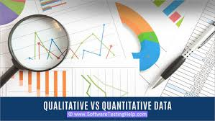
Mixed Methods Approach
You aren’t limited to just one approach.
If you need both quantitative and qualitative data, then collect both.
You can even collect both quantitative and qualitative data within one type of research instrument. In a survey, you can ask both open-ended questions about “Why?” as well as closed-ended, data-related questions.
Even in an unstructured format, like an interview or focus group, you can ask numerical questions to capture analyzable data.

Slide 17
Statistical Analysis

Slide 18
Statistical Analysis
Statistical analysis is the process of collecting and analyzing data in order to discern patterns and trends.
It is a method for removing bias from evaluating data by employing numerical analysis.
This technique is useful for collecting the interpretations of research, developing statistical models, and planning surveys and studies.

Slide 19
Cont…
It can be defined as a science of collecting and analyzing data to identify trends and patterns and presenting them.
Statistical analysis involves working with numbers and is used by businesses and other institutions to make use of data to derive meaningful information.

Slide 20
Cont…
Statistical analysis is a scientific tool in AI and ML that helps collect and analyze large amounts of data to identify common patterns and trends to convert them into meaningful information.
In simple words, statistical analysis is a data analysis tool that helps draw meaningful conclusions from raw and unstructured data.
The conclusions are drawn using statistical analysis facilitating decision-making and helping businesses make future predictions on the basis of past trends.

Slide 21
Types of Statistical Analysis
Statistical Analysis
Descriptive Analysis
Inferential Analysis
Predictive Analysis
Prescriptive Analysis
Exploratory Data Analysis
Causal Analysis

Slide 22
Descriptive Analysis
Descriptive statistical analysis involves collecting, interpreting, analyzing, and summarizing data to present them in the form of charts, graphs, and tables.
Rather than drawing conclusions, it simply makes the complex data easy to read and understand.

Slide 23
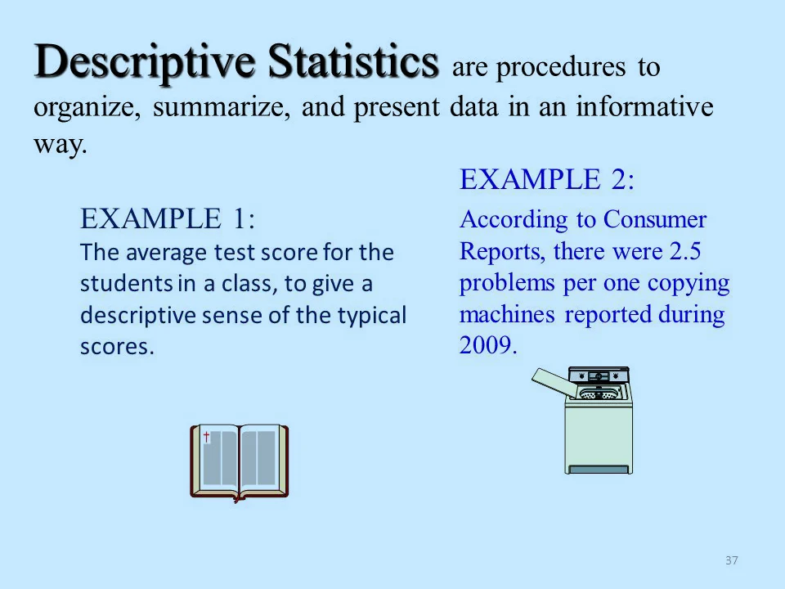
Descriptive Analysis (using statistics)

Slide 24
Descriptive statistics summarize a sample, for example the group of patients included in a clinical trial.
They have to be distinguished from inductive and explorative statistics, which aim to provide results for interpretation or to support the (main) analysis, respectively.
Clinical characteristics, such as the distribution of age or gender, or the proportion of subjects with related co-morbidities can be presented for the sample.

Slide 25
What does summarize mean?
In general, the reporting of descriptive statistics of single variables can include scatter parameters, such as the mean, the median, and the mode; and dispersion parameters, which are the range, quartiles, the variance, and the standard deviation.
For quantitative data, this usually includes the overall number of patients, and the number and percent of patients within the respective subgroup.
For qualitative data the mean, median, standard deviation, quartiles, and extreme values are reported.

Slide 26
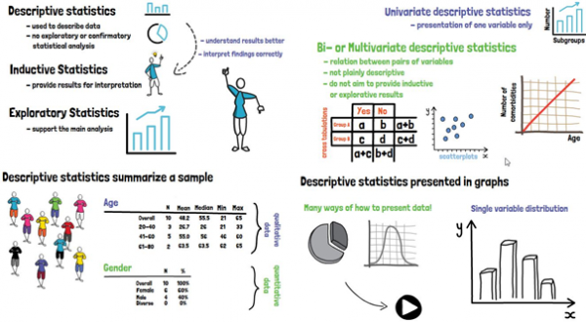

Slide 27
Descriptive statistics can additionally be presented in graphs, of which there are many possibilities, depending on what should or needs to be shown; the most common one being the histogram.

Slide 28
Inferential Analysis
Inferential statistical analysis is the method that will be used to draw the conclusions.
It allows users to infer or conclude trends about a larger population based on the samples that are analyzed.
Basically, it takes data from a sample and then makes conclusions about a larger population or group.
Inferential statistics can be defined as a field of statistics that uses analytical tools for drawing conclusions about a population by examining random samples.
The goal of inferential statistics is to make generalizations about a population.
In inferential statistics, a statistic is taken from the sample data (e.g., the sample mean) that used to make inferences about the population parameter (e.g., the population mean).

Slide 29
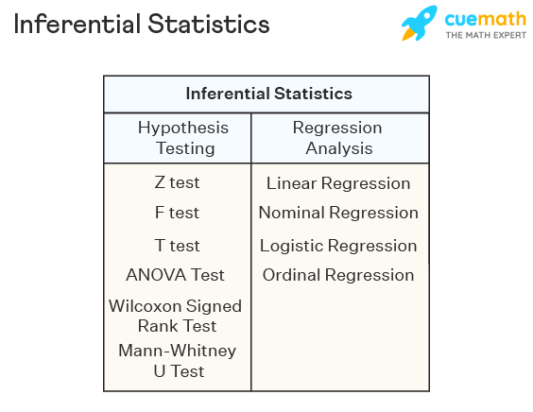
Types of Inferential Statistics
Inferential statistics can be classified into hypothesis testing and regression analysis.
Hypothesis testing also includes the use of confidence intervals to test the parameters of a population.
Given below are the different types of inferential statistics.

Slide 30
Inferential Statistics Examples
Inferential statistics is very useful and cost-effective as it can make inferences about the population without collecting the complete data.
Some inferential statistics examples are given below:
Suppose the mean marks of 100 students in a particular country are known.
Using this sample information the mean marks of students in the country can be approximated using inferential statistics.
Suppose a coach wants to find out how many average cartwheels sophomores at his college can do without stopping.
A sample of a few students will be asked to perform cartwheels and the average will be calculated.
Inferential statistics will use this data to make a conclusion regarding how many cartwheel sophomores can perform on average.

Slide 31
Exploratory Analysis
Exploratory data analysis (EDA) is used by data scientists to analyze and investigate data sets and summarize their main characteristics.
It helps determine how best to manipulate data sources to get the answers you need, making it easier for data scientists to discover patterns, spot anomalies, test a hypothesis, or check assumptions.
Data scientists can use exploratory analysis to ensure the results they produce are valid and applicable to any desired business outcomes and goals.
EDA also helps stakeholders by confirming they are asking the right questions.
EDA can help answer questions about standard deviations, categorical variables, and confidence intervals.
Once EDA is complete and insights are drawn, its features can then be used for more sophisticated data analysis or modeling, including machine learning.

Slide 32
Exploratory data analysis tools
Specific statistical functions and techniques you can perform with EDA tools include:
Clustering and dimension reduction techniques, which help create graphical displays of high-dimensional data containing many variables.
Univariate visualization of each field in the raw dataset, with summary statistics.
Bivariate visualizations and summary statistics that allow you to assess the relationship between each variable in the dataset and the target variable you’re looking at.
Multivariate visualizations, for mapping and understanding interactions between different fields in the data.
K-means Clustering is a clustering method in unsupervised learning where data points are assigned into K groups, i.e. the number of clusters, based on the distance from each group’s centroid.
The data points closest to a particular centroid will be clustered under the same category. K-means Clustering is commonly used in market segmentation, pattern recognition, and image compression.
Predictive models, such as linear regression, use statistics and data to predict outcomes.

Slide 33
Python: An interpreted, object-oriented programming language with dynamic semantics. Its high-level, built-in data structures, combined with dynamic typing and dynamic binding, make it very attractive for rapid application development, as well as for use as a scripting or glue language to connect existing components together. Python and EDA can be used together to identify missing values in a data set, which is important so you can decide how to handle missing values for machine learning.
R: An open-source programming language and free software environment for statistical computing and graphics supported by the R Foundation for Statistical Computing. The R language is widely used among statisticians in data science in developing statistical observations and data analysis.

Slide 34
Prescriptive Analysis
Prescriptive analytics is a type of data analytics that attempts to answer the question "What do we need to do to achieve this?"
It involves the use of technology to help businesses make better decisions through the analysis of raw data.
Prescriptive analytics specifically factors information about possible situations or scenarios, available resources, past performance, and current performance, and suggests a course of action or strategy.
It can be used to make decisions on any time horizon, from immediate to long-term.
It is the opposite of descriptive analytics, which examines decisions and outcomes after the fact.

Slide 35
Predictive Analysis
Prescriptive analytics is a form of data analytics that tries to answer "What do we need to do to achieve this?"
It uses machine learning to help businesses decide a course of action based on a computer program’s predictions.
Prescriptive analytics works with predictive analytics, which uses data to determine near-term outcomes.
When used effectively, it can help organizations make decisions based on facts and probability-weighted projections instead of conclusions based on instinct.
Prescriptive analytics isn't foolproof, as it's only as effective as its inputs.

Slide 36
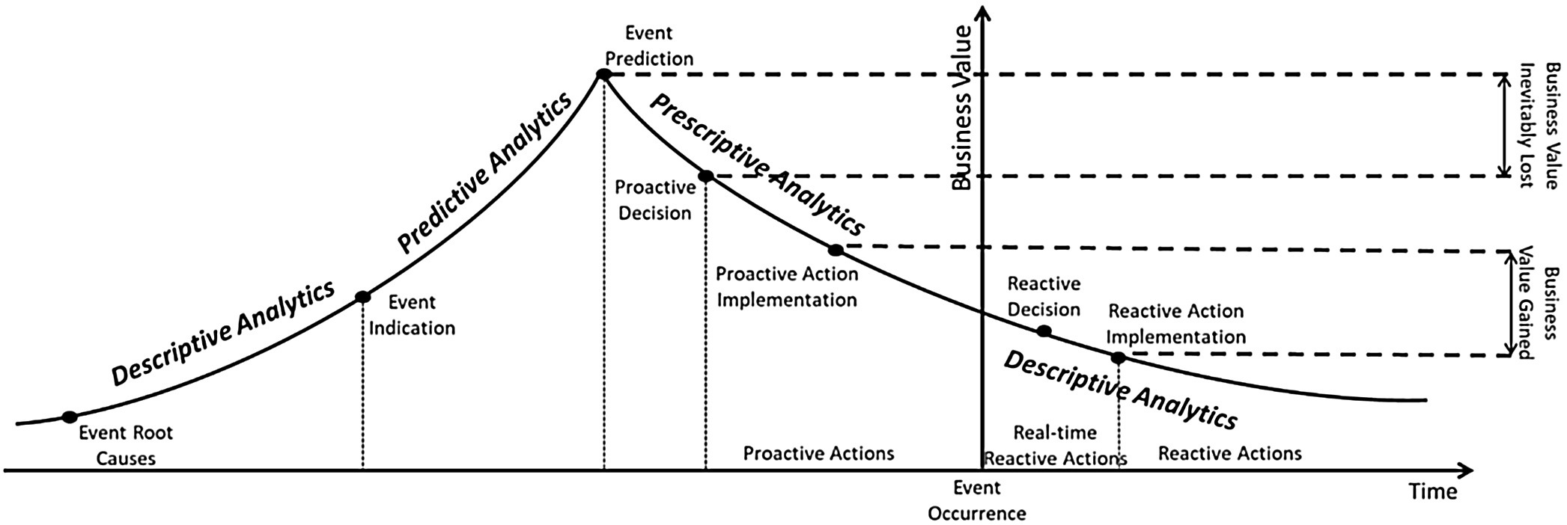
Predictive Analysis

Slide 37
Advantages
Prescriptive analytics can cut through the clutter of immediate uncertainty and changing conditions.
It can help prevent fraud, limit risk, increase efficiency, meet business goals, and create more loyal customers.
When used effectively, it can help organizations make decisions based on highly analyzed facts rather than jump to under-informed conclusions based on instinct.
Prescriptive analytics can simulate the probability of various outcomes and show the probability of each, helping organizations to better understand the level of risk and uncertainty they face than they could be relying on averages.
Organizations that use it can gain a better understanding of the likelihood of worst-case scenarios and plan accordingly.
Disadvantages
But prescriptive analytics is not foolproof.
It is only effective if organizations know what questions to ask and how to react to the answers.
As such, it's only effective if its inputs are valid. If the input assumptions are invalid, the output results will not be accurate.
This form of data analytics is only suitable for short-term solutions. This means businesses shouldn't use prescriptive analytics to make any long-term ones.
That's because it becomes more unreliable if more time is needed.
Not all prescriptive analytics providers are made the same.
So it's important for businesses to carefully consider the technology and who provides it.
Some may provide real, concrete results while others make the promise of big data and fail to deliver

Slide 38
Predictive Analysis
Predictive analytics uses statistics and modeling techniques to determine future performance.
Industries and disciplines, such as insurance and marketing, use predictive techniques to make important decisions.
Predictive models help make weather forecasts, develop video games, translate voice-to-text messages, customer service decisions, and develop investment portfolios.
People often confuse predictive analytics with machine learning even though the two are different disciplines.
Types of predictive models include decision trees, regression, and neural networks.

Slide 39
Uses of Predictive Analytics
Forecasting
Forecasting is essential in manufacturing because it ensures the optimal utilization of resources in a supply chain. Critical spokes of the supply chain wheel, whether it is inventory management or the shop floor, require accurate forecasts for functioning.
Predictive modeling is often used to clean and optimize the quality of data used for such forecasts. Modeling ensures that more data can be ingested by the system, including from customer-facing operations, to ensure a more accurate forecast.

Slide 40
Predictive Analysis
Human resources uses predictive analytics to improve various processes, such as forecasting future workforce needs and skills requirements or analyzing employee data to identify factors that contribute to high turnover rates.
Predictive analytics can also analyze an employee's performance, skills, and preferences to predict their career progression and help with career development planning in addition to forecasting diversity or inclusion initiatives

Slide 41
Causal Analysis
The causal statistical analysis focuses on determining the cause and effect relationship between different variables within the raw data.
In simple words, it determines why something happens and its effect on other variables.
This methodology can be used by businesses to determine the reason for failure.

Slide 42
Statistical Analysis Process
Given below are the 5 steps to conduct a statistical analysis that you should follow:
Step 1: Identify and describe the nature of the data that you are supposed to analyze.
Step 2: The next step is to establish a relation between the data analyzed and the sample population to which the data belongs.
Step 3: The third step is to create a model that clearly presents and summarizes the relationship between the population and the data.
Step 4: Prove if the model is valid or not.
Step 5: Use predictive analysis to predict future trends and events likely to happen.

Slide 43
Statistical Analysis Methods
Although there are various methods used to perform data analysis, given below are the 5 most used and popular methods of statistical analysis:
Mean
Standard Deviation
Regression
Hypothesis Testing
Sample Size Determination

Slide 44
Mean
Mean or average mean is one of the most popular methods of statistical analysis.
Mean determines the overall trend of the data and is very simple to calculate.
Mean is calculated by summing the numbers in the data set together and then dividing it by the number of data points.
Despite the ease of calculation and its benefits, it is not advisable to resort to mean as the only statistical indicator as it can result in inaccurate decision making.

Slide 45
Standard Deviation
Standard deviation is another very widely used statistical tool or method.
It analyzes the deviation of different data points from the mean of the entire data set.
It determines how data of the data set is spread around the mean.
You can use it to decide whether the research outcomes can be generalized or not.

Slide 46
Regression
Regression is a statistical tool that helps determine the cause and effect relationship between the variables.
It determines the relationship between a dependent and an independent variable.
It is generally used to predict future trends and events.

Slide 47
Hypothesis Testing
Hypothesis testing can be used to test the validity or trueness of a conclusion or argument against a data set.
The hypothesis is an assumption made at the beginning of the research and can hold or be false based on the analysis results.

Slide 48
Sample Size Determination
Sample size determination or data sampling is a technique used to derive a sample from the entire population, which is representative of the population.
This method is used when the size of the population is very large.
You can choose from among the various data sampling techniques such as snowball sampling, convenience sampling, and random sampling.

Slide 49
Statistical Analysis Examples
Look at the standard deviation sample calculation given below to understand more about statistical analysis.
The weights of 5 pizza bases in cms are as follows:

Slide 50
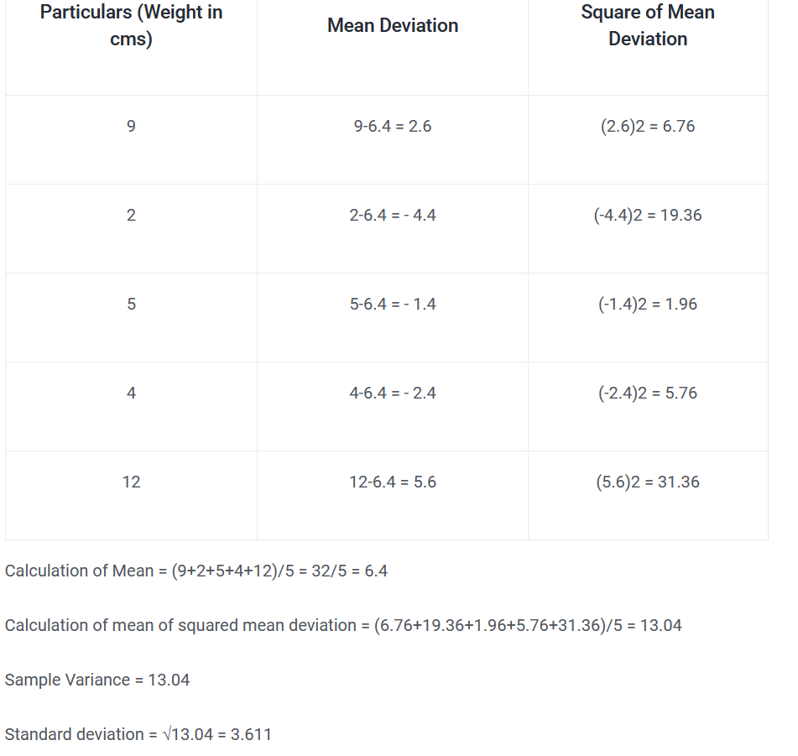

Slide 51
Data Mining
Let us understand the meaning of the term mining by taking the example of mining of gold from rocks, which is called gold mining.
Here the useful thing is “Gold”, hence it is called gold mining.
Similarly taking out useful information from a vast amount of data is termed as Knowledge mining, and is popularly known as Data Mining.
By the term useful information, we denote the data which can help us in predicting an output.

Slide 52
Data Analysis Process
The knowledge discovery process is a sequence of the following steps:
Data Cleaning: This step removes noise and inconsistent data from the input data.
Data Integration: This step combines multiple sources of data. The data cleaning and data integration step together to form the preprocessing of data. The preprocessed data is then stored in the data warehouse.
Data Selection: These steps select the data to the analysis task from the database.
Data Transformation: In this step, various data aggregation and data summary techniques are applied to transform the data into a useful form for mining.
Data Mining: In this step, data patterns are extracted by applying intelligent methods.
Pattern Evaluation: The extracted data patterns are evaluated and recognized according to the interestingness measures.
Knowledge Representation: Visualization and knowledge representation techniques are used to present the mined knowledge to the users.

Slide 53
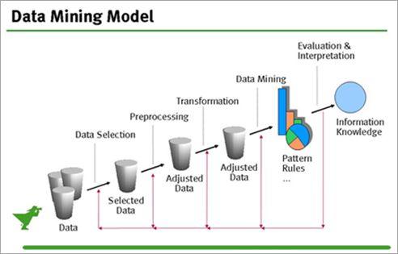
Data Mining Model
The steps 1 to 4 come under the data preprocessing stage.
Here, data mining is represented as a single step but it refers to the entire knowledge discovery process.
Thus, we can say, that data analysis is the process of discovering interesting patterns and knowledge from a large amount of data.
The data sources can include databases, data warehouses, World Wide Web, flat files and other informative files.

Slide 54
What Techniques Are Used In Data Mining?
Data Mining is a highly application-driven domain. Many techniques such as statistics, machine learning, pattern recognition, information retrieval, visualization, etc., influence the development of data analysis methods.
Statistics
Machine Learning
Information Retrieval (IR)

Slide 55
Statistics
The study of collection, analysis, interpretation, and presentation of data can be done using Statistical Models.
For example, statistics can be used to model noise and missing data, and then this model can be used in large data set to identify the noise and missing values in data.

Slide 56
Machine Learning
ML is used to improve performance based on data. The main research area is for computer programs to automatically learn to recognize complex patterns and make intelligent decisions based on the data.
Machine Learning focuses on accuracy and data mining focuses on the efficiency and scalability of mining methods on the large data set, complex data, etc.
Machine learning is of three types:
Supervised Learning: The target data set is known and the machine is trained according to the target values.
Unsupervised Learning: The target values are not known and the machines learn by themselves.
Semi-Supervised Learning: It uses both the techniques of supervised and unsupervised learning.

Slide 57
Information Retrieval (IR)
It is the science of searching for documents or information in documents.
It uses two principles:
1.Data that is to be searched is unstructured.
2. The queries are formed mainly by keywords.
By using data analysis and IR, we can find major topics in the collection of documents and also the major topics involved in each document.

Slide 58
Semantic Analysis
What Is Semantic Analysis?
Semantic analysis refers to a process of understanding natural language (text) by extracting insightful information such as context, emotions, and sentiments from unstructured data.
It gives computers and systems the ability to understand, interpret, and derive meanings from sentences, paragraphs, reports, registers, files, or any document of a similar kind.

Slide 59
Cont…
Semantic analysis analyzes the grammatical format of sentences, including the arrangement of words, phrases, and clauses, to determine relationships between independent terms in a specific context.
This is a crucial task of natural language processing (NLP) systems.
It is also a key component of several machine learning tools available today, such as search engines, chatbots, and text analysis software.

Slide 60
Cont…
The semantic analysis process begins by studying and analyzing the dictionary definitions and meanings of individual words also referred to as lexical semantics.
Following this, the relationship between words in a sentence is examined to provide clear understanding of the context.
When fueled by natural language processing and machine learning, systems of semantic analysis tend to achieve human-level accuracy.
Several companies rely heavily on semantic analysis-driven tools that automatically draw valuable data from unstructured data such as emails, client reports, and customer reviews.

Slide 61
How Does Semantic Analysis Work?
The semantic analysis method begins with a language-independent step of analyzing the set of words in the text to understand their meanings.
This step is termed ‘lexical semantics‘ and refers to fetching the dictionary definition for the words in the text.
Subsequently, words or elements are parsed.
Each element is designated a grammatical role, and the whole structure is processed to cut down on any confusion caused by ambiguous words having multiple meanings.

Slide 62
Cont…
Upon parsing, the analysis then proceeds to the interpretation step, which is critical for artificial intelligence algorithms.
For example, the word ‘Blackberry’ could refer to a fruit, a company, or its products, along with several other meanings.
Moreover, context is equally important while processing the language, as it takes into account the environment of the sentence and then attributes the correct meaning to it.

Slide 63
Cont…
For example, ‘Blackberry is known for its sweet taste’ may directly refer to the fruit, but ‘I got a blackberry’ may refer to a fruit or a Blackberry product.
As such, context is vital in semantic analysis and requires additional information to assign a correct meaning to the whole sentence or language

Slide 64
Cont…
Technically, semantic analysis involves:
1.Data processing
2.Defining features, parameters, and characteristics of processed data
3. Data representation
4. Defining grammar for data analysis
5.Assessing semantic layers of processed data
6. Performing semantic analysis based on the linguistic formalism

Slide 65
Examples of Semantic Analysis
Semantic analysis plays a vital role in :
Automated handling of customer grievances,
Managing customer support tickets,
Dealing with chats and direct messages via chatbots or call bots, among other tasks.

Slide 66
Machine Learning
Machine Learning is one of the most crucial subsets of Artificial Intelligence in the computer science field. It is referred to as the study of automated data processing or decision-making algorithms that improve themselves automatically based on experience or past experience.
It makes systems capable of learning automatically and improves from experience without being explicitly programmed. The primary aim of a machine learning model is to develop computer programs that can access data and use it for learning purposes.

Slide 67
Cont…
Image recognition
Speech Recognition
Healthcare
Finance and Banking industry
Computational Biology
Energy production
Automation
Self-driven vehicle
Natural Language Processing (NLP)
Personal virtual assistance
Marketing and Trading
The education sector, etc.
With the rise in Big Data, Machine Learning has become a key player in solving problems in various areas such as:

Slide 68
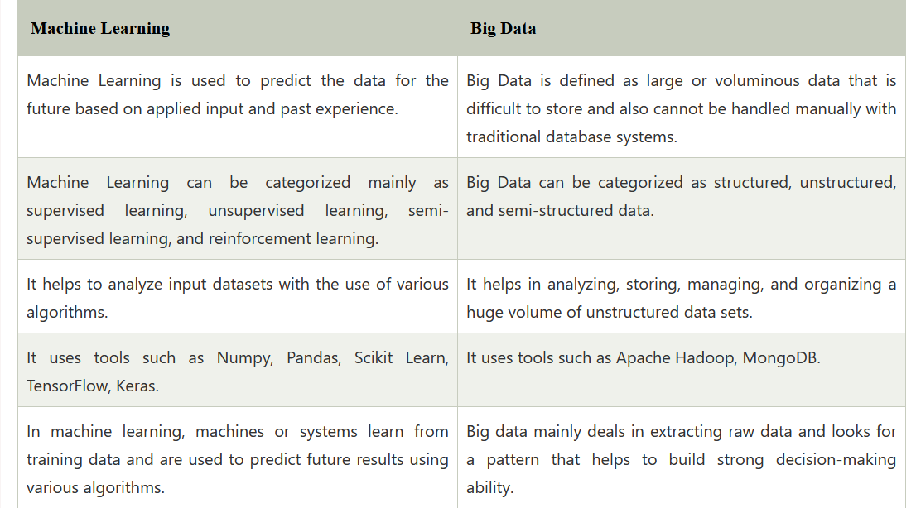
Difference between Big Data and Machine Learning

Slide 69
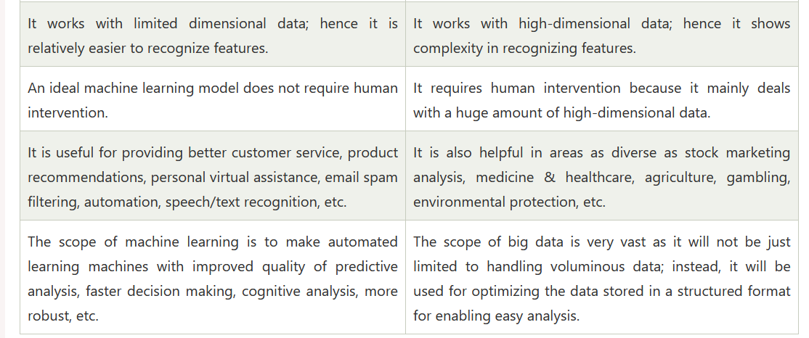
Cont…

Slide 70
Big data with Machine Learning
Machine Learning is a very crucial technology, and with big data, it has become more powerful for data collection, data analysis, and data integration.
All big organizations use machine learning algorithms for running their business properly.
We can apply machine learning algorithms to every element of Big data operation, including:
Data Labeling and Segmentation
Data Analytics
Scenario Simulation

Slide 71
Cont…
In machine learning algorithms, we need multiple varieties of data for training a machine and predicting accurate results.
However, sometimes it becomes difficult to manage these bulkified data.
So, it becomes a challenge to manage and analyze Big Data.
Further, this unstructured data is useless until it is well interpreted.
Thus, to use information, there is a need for talent, algorithms, and computing infrastructure.

Slide 72
Cont…
Machine Learning enables machines or systems to learn from past experience and use data received from big data, and predict accurate results.
Hence, this leads to generating improved quality business operations and building better customer relationship management.
Big Data helps machine learning by providing a variety of data so machines can learn more or multiple samples or training data.

Slide 73
Cont…
In such ways, businesses can accomplish their dreams and get the benefit of big data using ML algorithms. However, for using the combination of ML and big data, companies need skilled data scientists.
How to apply Machine Learning in Big data:
Machine Learning provides efficient and automated tools for data gathering, analysis, and integration.
In collaboration with cloud computing superiority, machine learning ingests agility into processing and integrates large amounts of data regardless of its source.

Slide 74
Visual Analysis
Visual analytics is the use of sophisticated tools and processes to analyze datasets using visual representations of the data.
Visualizing the data in graphs, charts, and maps helps users identify patterns and thereby develop actionable insights.
These insights help organizations make better, data-driven decisions.
Just like a picture speaks thousands of words, Visual Analytics can talk thousands of data points.

Slide 75
Difference between Data Visualization and Visual analytics
Visual Analytics
Data Visualization
Data visualization, visual analytics isn’t simply a matter of representing data graphically.
Modern, interactive visual analytics makes it easy to combine data from multiple sources and deeply analyze the data directly within the visualization itself.
Plus, AI and machine learning algorithms can offer recommendations to help guide your exploration.
Data visualization means showing data in a visual format that makes insights easier to understand for human users.
Data is usually visualized in a pictorial or graphical form such as charts, graphs, lists, maps, and comprehensive dashboards that combine these multiple formats.

Slide 76
Cont…
Visual Analytics
Data Visualization
Visual analytics does the “heavy lifting” with data, by using a variety of processes — mechanical, algorithms, machine learning, natural language processing, etc — to identify and reveal patterns and trends.
It prepares the data for the process of data visualization, thereby enabling users to examine data, understand what it means, interpret the patterns it highlights, and help them find meaning and gain useful insights from complex data sets.
The primary objective of data visualization is to clearly communicate what the data says, help explain trends and statistics, and show patterns that would otherwise be impossible to see.
Data visualization is used to make the consuming, interpreting, and understanding data as simple as possible, and to make it easier to derive insights from data.
When BI and analytics users want to see analytics results, and learn from them quickly, they rely on data visualizations.

Slide 77
Advantages of Visual Analytics
Share findings and track progress: Interactive reports and dashboards help users track, organize and share key performance indicators across an organization.
Make faster decisions: Users can understand data insights much more quickly by seeing and working with data sets when they are in a visual format.
Explore data more easily: Self-service analytics tools which allow users to interact with data in a visual context allows them to discover hidden relationships and patterns in the data without relying on help from IT.
Promote data literacy: Making data easier to work with and understand democratizes data analytics, getting more people across and organization involved.
Ultimately, visual analytics helps you turn massive data sets into business insights which can have a major positive impact on your organization.

Slide 78
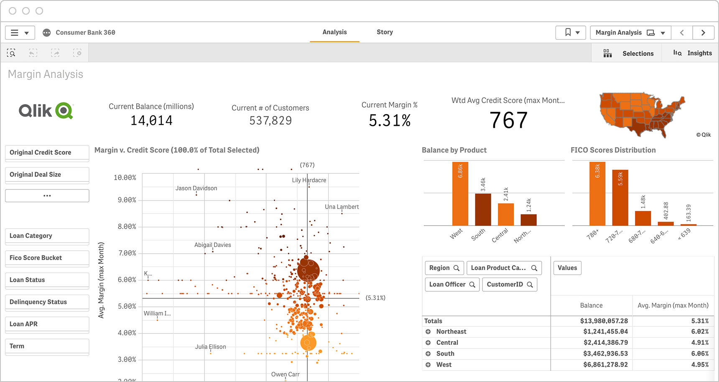
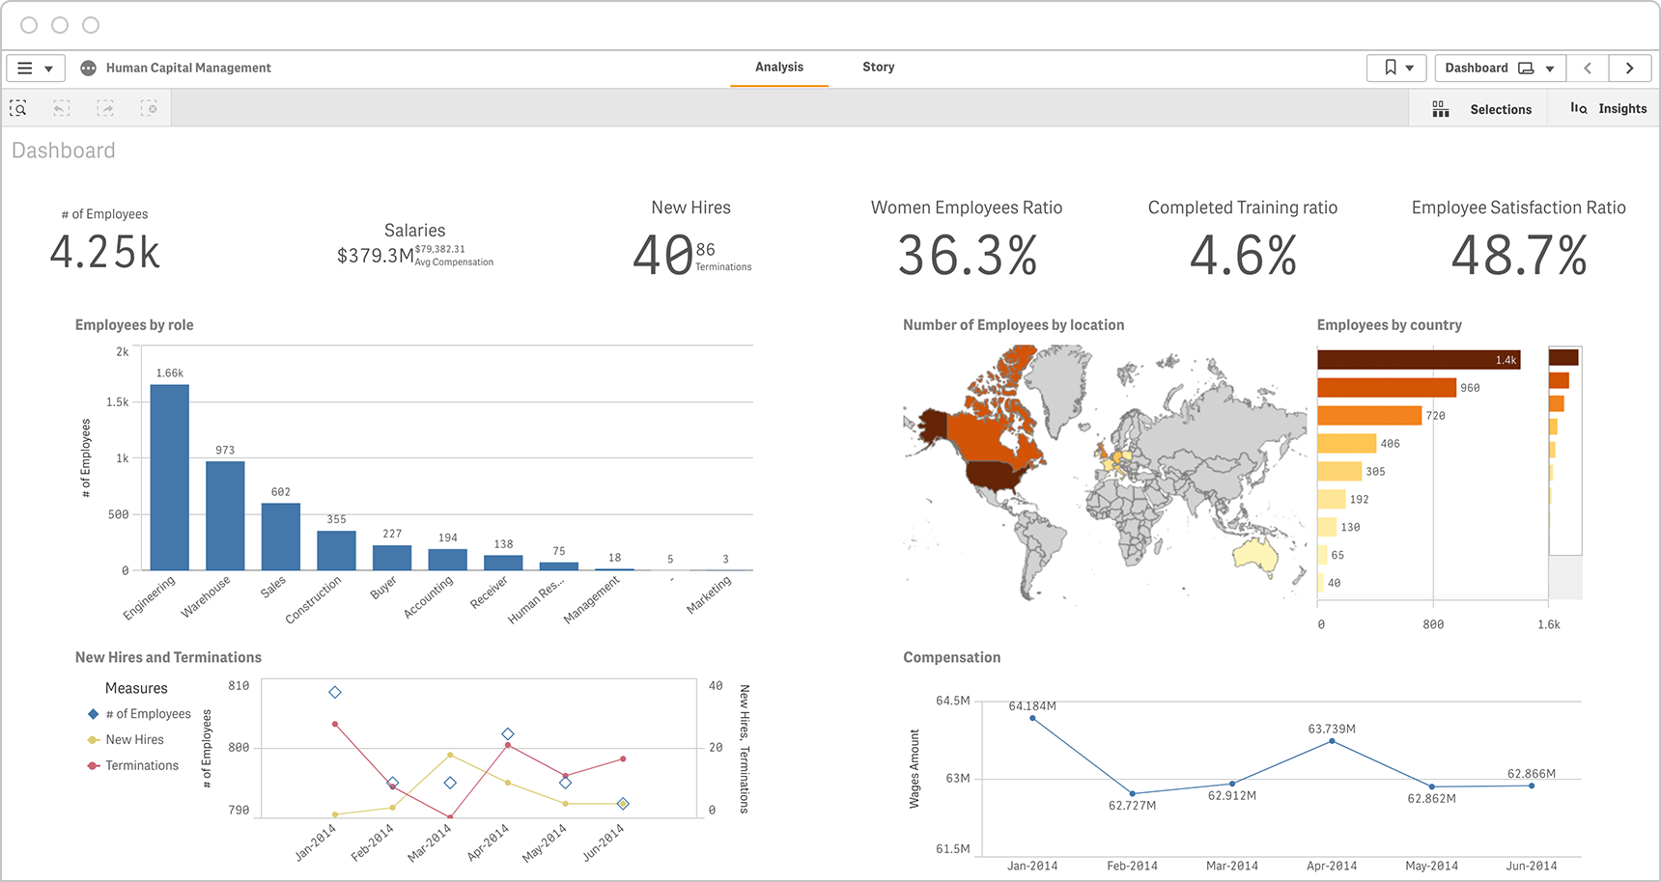
Example –Visual Analytics

Slide 79
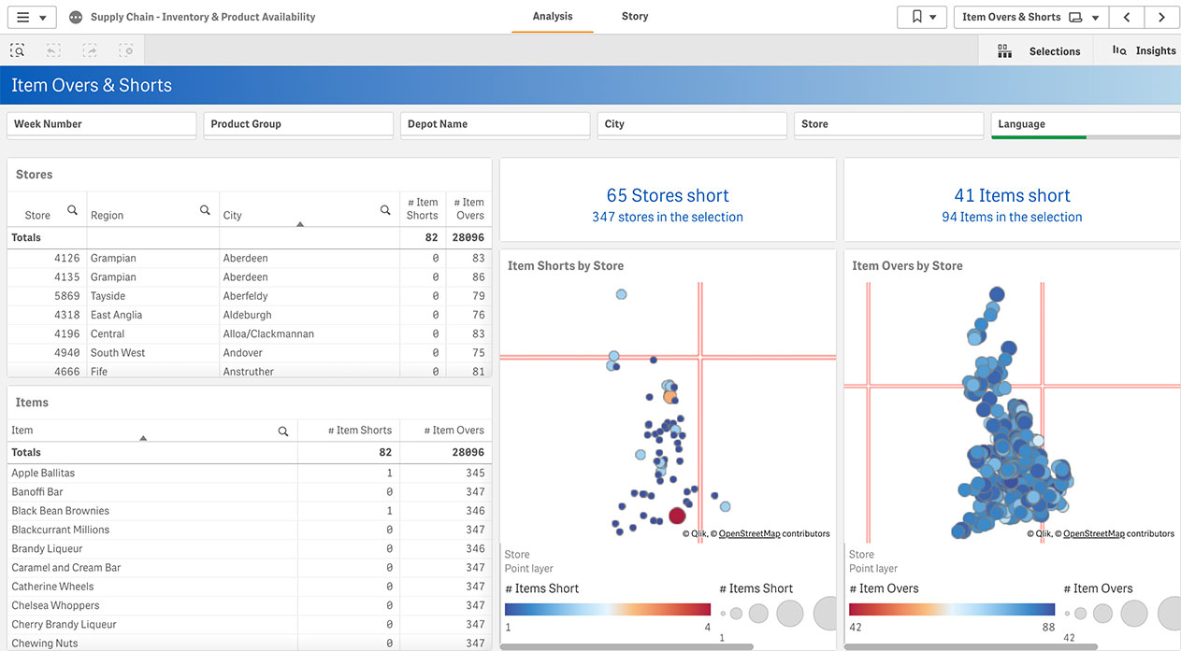
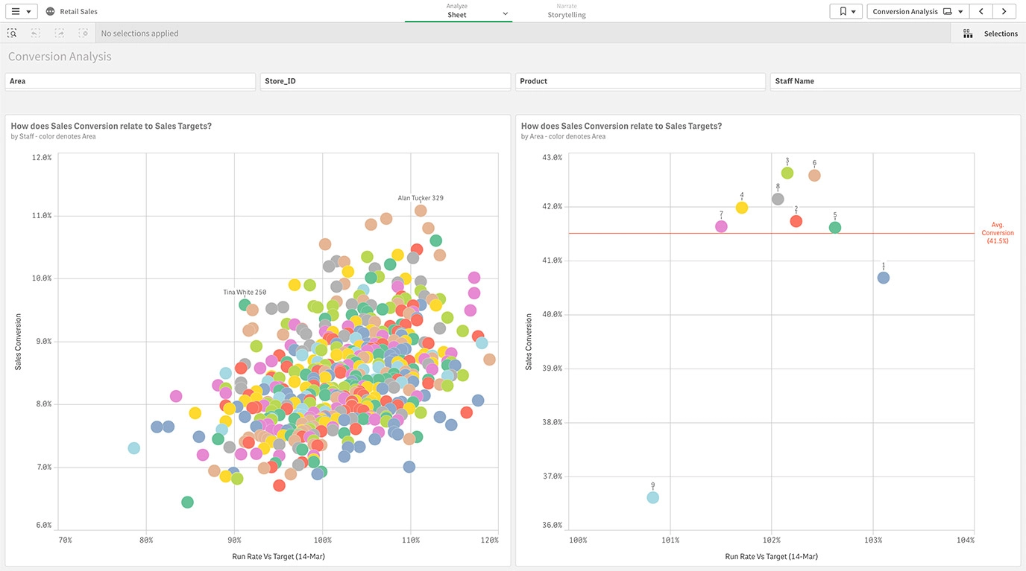
Example-Visual Analytics

